Slide 1
基底函數 The Basis Set
影響計算準確度的關鍵因素
The crucial factor that determines the accuracy of the calculation

Slide 2
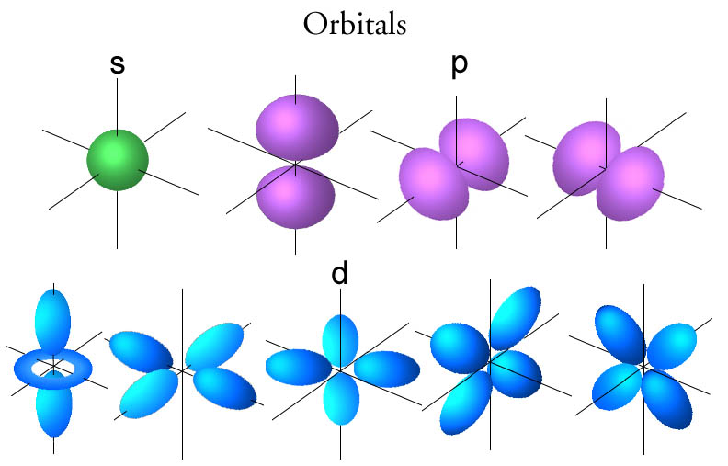
AO and MO MOs are linear combination of AOs LCAO-MO
hydrogen-like AOs：
Slater-Type Orbital (STO)
Gaussian-Type Orbital (GTO)
i + j + k
0 s-type (1)
1 p-type (3)
2 d-type (6)
3 f-type (10)
Cartesian Gaussian

Slide 3
Modern calculation uses GTO greatly simplifies the two-electron integrals
Contracted-Gaussian-Type Function (CGTF) uses LC-GTO to mimic STO
Basis Set all the AOs (CGTF) in a molecular calculation
Minimal Basis Set (STO-3G) the basis set that includes the same numbers and types of GTFs as the hydrogen-like orbitals (used in most chemistry courses)
g_{i} : primitive gaussians

Slide 4
Split-Valence Basis Set 兼顧準確度與計算效率 compromise between accuracy and efficiency
Valence Double-Zeta Basis Set Core：minimal basis Valence：two CGTF for an AO examples：3-21G, 6-31G (numbers show the primitive gaussians in CGTF)
Valence Triple-Zeta Basis Set Core：minimal basis Valence： three CGTF for an AO examples：6-311G，TZV，def2TZV

Slide 5
Polarization and Diffuse Functions for accurate calculation on the chemical bonding
polarization functions→ increase the angular moment of GTO first-period: adding p-type and higher GTOs second-period: adding d-type and higher GTOs examples:：6-31G(d,p) [6-31G**], 6-311G(3d2f,2pd) cc-pVDZ, cc-pVTZ
diffuse functions → extend the range of GTO (small Z) 6-31G(d,p) plus s, p → 6-31+G(d,p) cc-pVDZ plus s, p, d → aug-cc-pVDZ

Slide 6
Basis Sets Suggestions from rules to arts Theory/Basis Set
MP2, DFT : 6-31G(d) or larger (scale as N⁴ to N⁵)
bonding changes for H atom：6-31G(d,p), cc-pVDZ
anions, hydrogen bonding, excited states： 6-31+G(d,p), aug-cc-pVDZ
high-level theory: triple-zeta or larger: aug-cc-pVTZ, 6-311+G(3d2f,2pd) (scale as N⁶ to N⁷)
The choices of basis sets are related to the properties of the system, accuracy and time requirements, computational resource available. Proper selection is not only a professional skill, but also a high art.

Slide 7
Case Study: 6-31+G(d,p)
#HF/6-31+G(d,p) GFInput
Water
0 1
H
O 1 R
H 2 R 1 A
Variables:
R 0.97
A 104.5
Standard basis: 6-31+G(d,p) (6D, 7F)
AO basis set in the form of general basis input (Overlap normalization):
1 0
S 3 1.00 0.000000000000
0.1873113696D+02 0.3349460434D-01
0.2825394365D+01 0.2347269535D+00
0.6401216923D+00 0.8137573261D+00
S 1 1.00 0.000000000000
0.1612777588D+00 0.1000000000D+01
P 1 1.00 0.000000000000
0.1100000000D+01 0.1000000000D+01
****

Slide 8
2 0
S 6 1.00 0.000000000000
0.5484671660D+04 0.1831074430D-02
0.8252349460D+03 0.1395017220D-01
0.1880469580D+03 0.6844507810D-01
0.5296450000D+02 0.2327143360D+00
0.1689757040D+02 0.4701928980D+00
0.5799635340D+01 0.3585208530D+00
SP 3 1.00 0.000000000000
0.1553961625D+02 -0.1107775495D+00 0.7087426823D-01
0.3599933586D+01 -0.1480262627D+00 0.3397528391D+00
0.1013761750D+01 0.1130767015D+01 0.7271585773D+00
SP 1 1.00 0.000000000000
0.2700058226D+00 0.1000000000D+01 0.1000000000D+01
SP 1 1.00 0.000000000000
0.8450000000D-01 0.1000000000D+01 0.1000000000D+01
D 1 1.00 0.000000000000
0.8000000000D+00 0.1000000000D+01
****
3 0
S 3 1.00 0.000000000000
0.1873113696D+02 0.3349460434D-01
0.2825394365D+01 0.2347269535D+00
0.6401216923D+00 0.8137573261D+00
S 1 1.00 0.000000000000
0.1612777588D+00 0.1000000000D+01
P 1 1.00 0.000000000000
0.1100000000D+01 0.1000000000D+01
****
29 basis functions, 46 primitive gaussians,
5 alpha electrons 5 beta electrons nuclear repulsion energy 9.0736758041 Hartrees.
Initial guess orbital symmetries:
Occupied (A1) (A1) (B2) (A1) (B1)
Virtual (A1) (B2) (A1) (B1) (B2) (A1) (B2) (A1) (B1) (B2)
(A1) (A1) (A2) (A1) (B1) (A1) (B2) (B2) (A2) (B1)
(A1) (A1) (B2) (A1)

Slide 9
Case Study: aug-cc-pVDZ
#HF/6-31+G(d,p) GFInput
Water
0 1
H
O 1 R
H 2 R 1 A
Variables:
R 0.97
A 104.5
Standard basis: Aug-CC-pVDZ (5D, 7F)
AO basis set in the form of general basis input (Overlap normalization):
1 0
S 3 1.00 0.000000000000
0.1301000000D+02 0.3349872639D-01
0.1962000000D+01 0.2348008012D+00
0.4446000000D+00 0.8136829579D+00
S 1 1.00 0.000000000000
0.1220000000D+00 0.1000000000D+01
S 1 1.00 0.000000000000
0.2974000000D-01 0.1000000000D+01
P 1 1.00 0.000000000000
0.7270000000D+00 0.1000000000D+01
P 1 1.00 0.000000000000
0.1410000000D+00 0.1000000000D+01
****

Slide 10
2 0
S 7 1.00 0.000000000000
0.1172000000D+05 0.7118644339D-03
0.1759000000D+04 0.5485201992D-02
0.4008000000D+03 0.2790992963D-01
0.1137000000D+03 0.1051332075D+00
0.3703000000D+02 0.2840024898D+00
0.1327000000D+02 0.4516739459D+00
0.5025000000D+01 0.2732081255D+00
S 7 1.00 0.000000000000
0.1172000000D+05 0.7690300460D-05
0.4008000000D+03 0.3134845790D-03
0.1137000000D+03 -0.2966148530D-02
0.3703000000D+02 -0.1087535430D-01
0.1327000000D+02 -0.1207538168D+00
0.5025000000D+01 -0.1062752639D+00
0.1013000000D+01 0.1095975478D+01
S 1 1.00 0.000000000000
0.3023000000D+00 0.1000000000D+01
S 1 1.00 0.000000000000
0.7896000000D-01 0.1000000000D+01
P 3 1.00 0.000000000000
0.1770000000D+02 0.6267916628D-01
0.3854000000D+01 0.3335365659D+00
0.1046000000D+01 0.7412396416D+00
P 1 1.00 0.000000000000
0.2753000000D+00 0.1000000000D+01
P 1 1.00 0.000000000000
0.6856000000D-01 0.1000000000D+01
D 1 1.00 0.000000000000
0.1185000000D+01 0.1000000000D+01
D 1 1.00 0.000000000000
0.3320000000D+00 0.1000000000D+01
****
41 basis functions, 65 primitive gaussians, 43 cartesian basis functions
5 alpha electrons 5 beta electrons
nuclear repulsion energy 9.0736758041 Hartrees

Slide 11
General Basis Set
#MP2/Gen GFInput /6-31+G(d,p)
He
0 1
He
1 0
S 3 1.00 0.000000000000
0.3842163400D+02 0.4013973935D-01
0.5778030000D+01 0.2612460970D+00
0.1241774000D+01 0.7931846246D+00
S 1 1.00 0.000000000000
0.2979640000D+00 0.1000000000D+01
S 1 1.00 0.000000000000
0.8600000000D-01 0.1000000000D+01
P 1 1.00 0.000000000000
0.1100000000D+01 0.1000000000D+01
S 1 1.00
0.03 1.00
P 1 1.00
0.40 1.00
****
#MP2/Gen GFInput /6-31+G(d,p)
He
0 1
He
He 0
6-31++G(d,p)
****
S 1 1.00
0.03 1.00
P 1 1.00
0.40 1.00
****

Slide 12
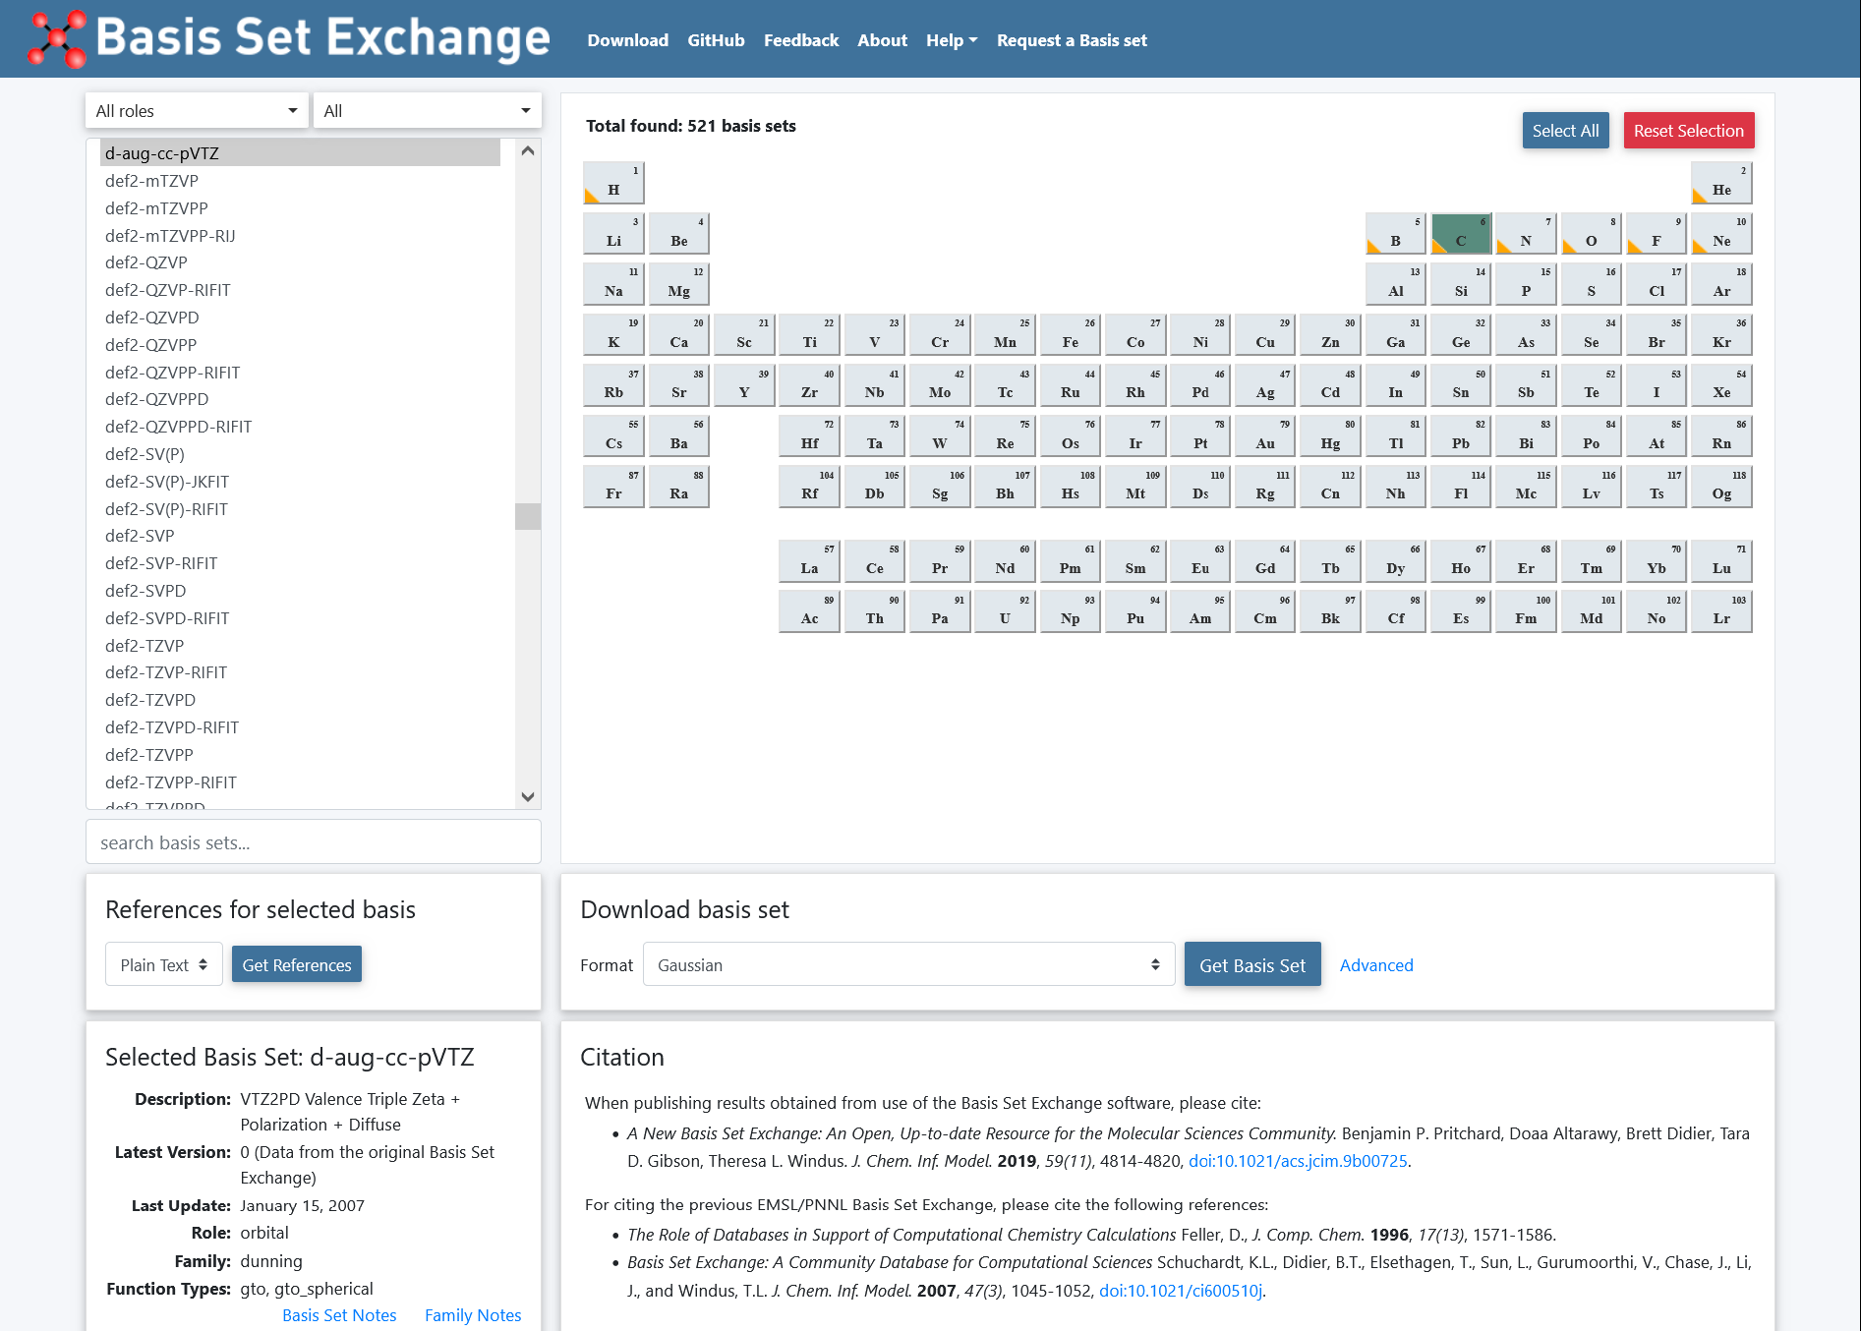

Slide 13
Exercise 9 (2024/11/26)
Calculate the EAs of He, Ne, and Ar by adding diffuse functions to 6-31++G(d,p) basis sets. (HF, MP2, B3LYP)
Calculate the EAs of He, Ne, and Ar by using the d-aug-cc-pVTZ basis sets. (HF, MP2, B3LYP)
Calculate the total atomization energies of H₂, CH₄, NH₃, H₂O, HF, CO, N₂, HCN using MP2, B3LYP, M06-2X with 6-31+G(d,p), and compare them to the accurate data. (D_{e})
Calculate the structure and bond energy of AuCl₄⁻ complex using the B3LYP functional with the aug-cc-pVDZ(pp) basis set.

