Slide 1
Molecular Modeling using WebMO
Wei-Ping Hu
Department of Chemistry and Biochemistry
National Chung Cheng University

Slide 2
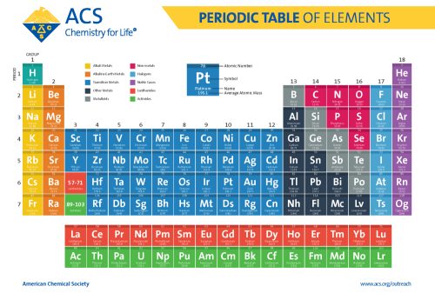

Slide 3
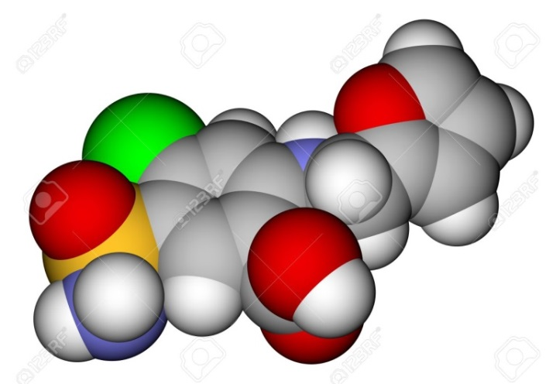
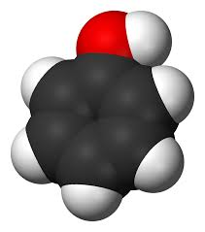
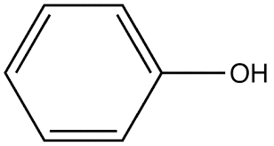
Molecular Modeling
Model What？
Structure → Properties → Chemistry
C₆H₆O → →
3-D structures →
Thermodynamics, Electron Density, Spectroscopy,
Molecular Interaction, Chemical Reactions

Slide 4

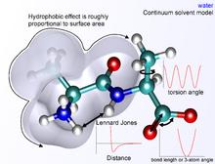
Molecular Modeling needs a force field

Slide 5
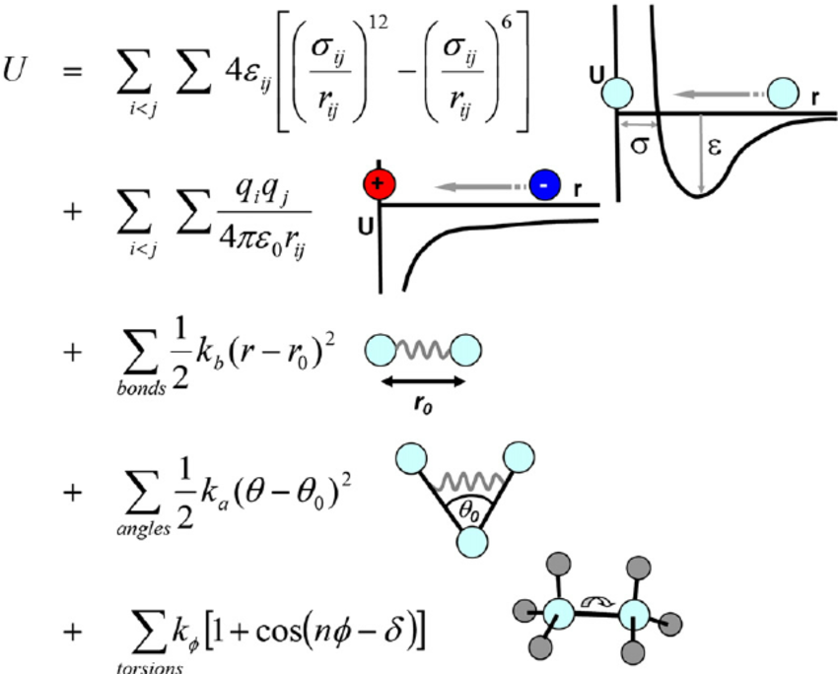
Molecular Mechanics Force Field
(MMFF, Functional Form + Parameter Sets)
Total energy is the sum of the functional forms：
Parameters are from experimental data or quantum chemical calculation
Commonly used Force Fields:
AMBER
CHARMM
UFF
MMFF
MM2, MM3, MM4
VSEPR
no electrons, bonds do not break!
Quantum Chemistry: HF, MP2, DFT, Semiempirical: PM3, AM1

Slide 6
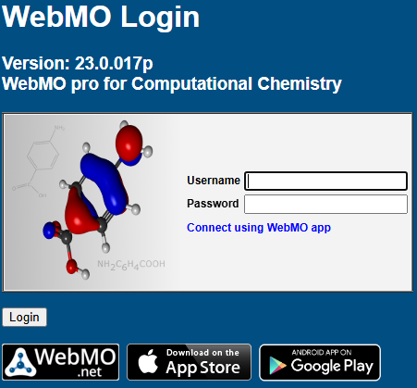

How to Login WebMO?
Connect to WebMO Page from your Web Browser
Find the username and passwd the TA provided
Enter the account info. to login
http://apollo.chem.ccu.edu.tw/~WebMO/cgi-bin/webmo_pro/login.cgi

Slide 7
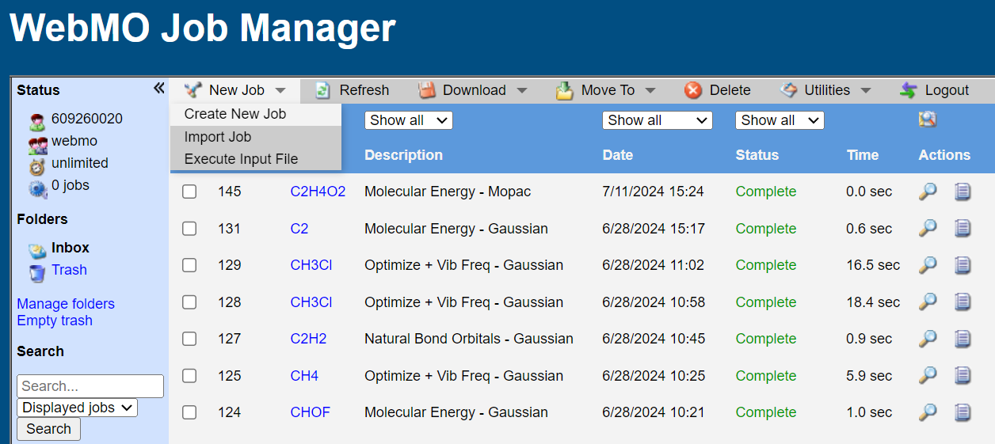
Job manager
After you log in, you see the Job Manager page listing all the job you have submitted.
1
2
Press「New job」and then「Create new job 」to open「 Build molecule 」page

Slide 8
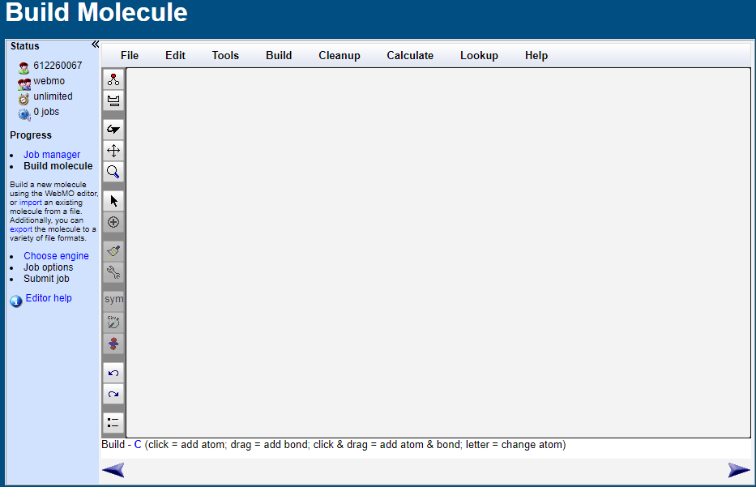
Build Molecule
1. Molecular Editor Window
2. Function Menu
3. Tool Bar
4. Progress
5. Current Mode
6. Previous Step
7. Next Step
2
4
3
1
5
6
7

Slide 9
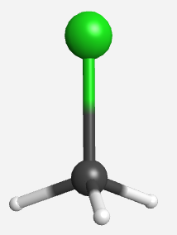

Build Molecule
Chloromethane Molecule (CH₃Cl)：
1. Click in the window to insert the C atom
2. Click Build → Other to select Cl and pull it out from C to generate C-Cl
Choose Cleanup or

Slide 10
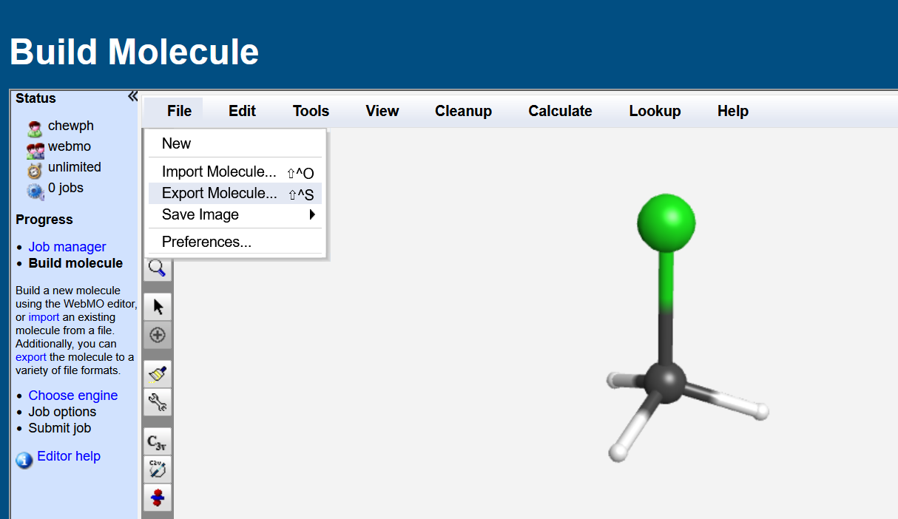
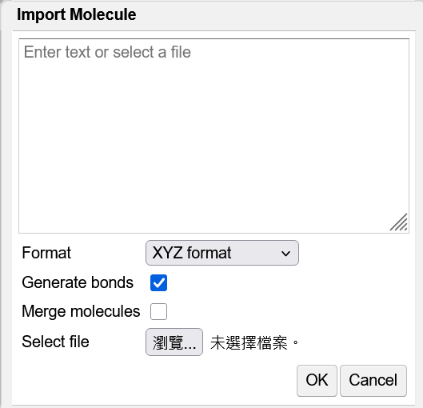
Save Molecule
Click File → Export Molecule → XYZ format → OK
You may want to rename it.
You can Import the molecule later on.

Slide 11
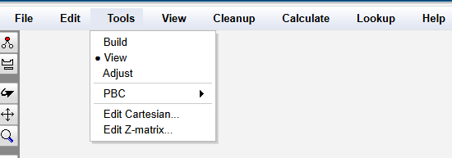

Build Molecule - Tools
Build：Add new atoms
View：Rotate, translate, or scale molecules
Adjust：Change the key length, key angle, or dihedral angle

Slide 12
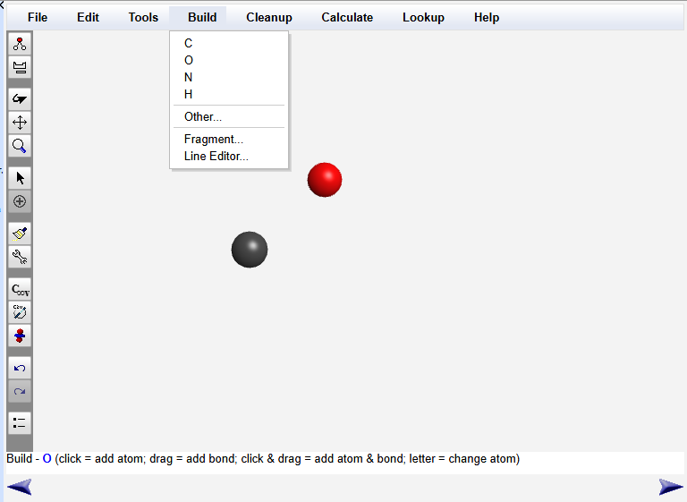
Build
After selecting Build, the right side of Tools in the upper toolbar will change to Build. Click Build to build atoms. To select other atoms, click Periodic Table.

Slide 13
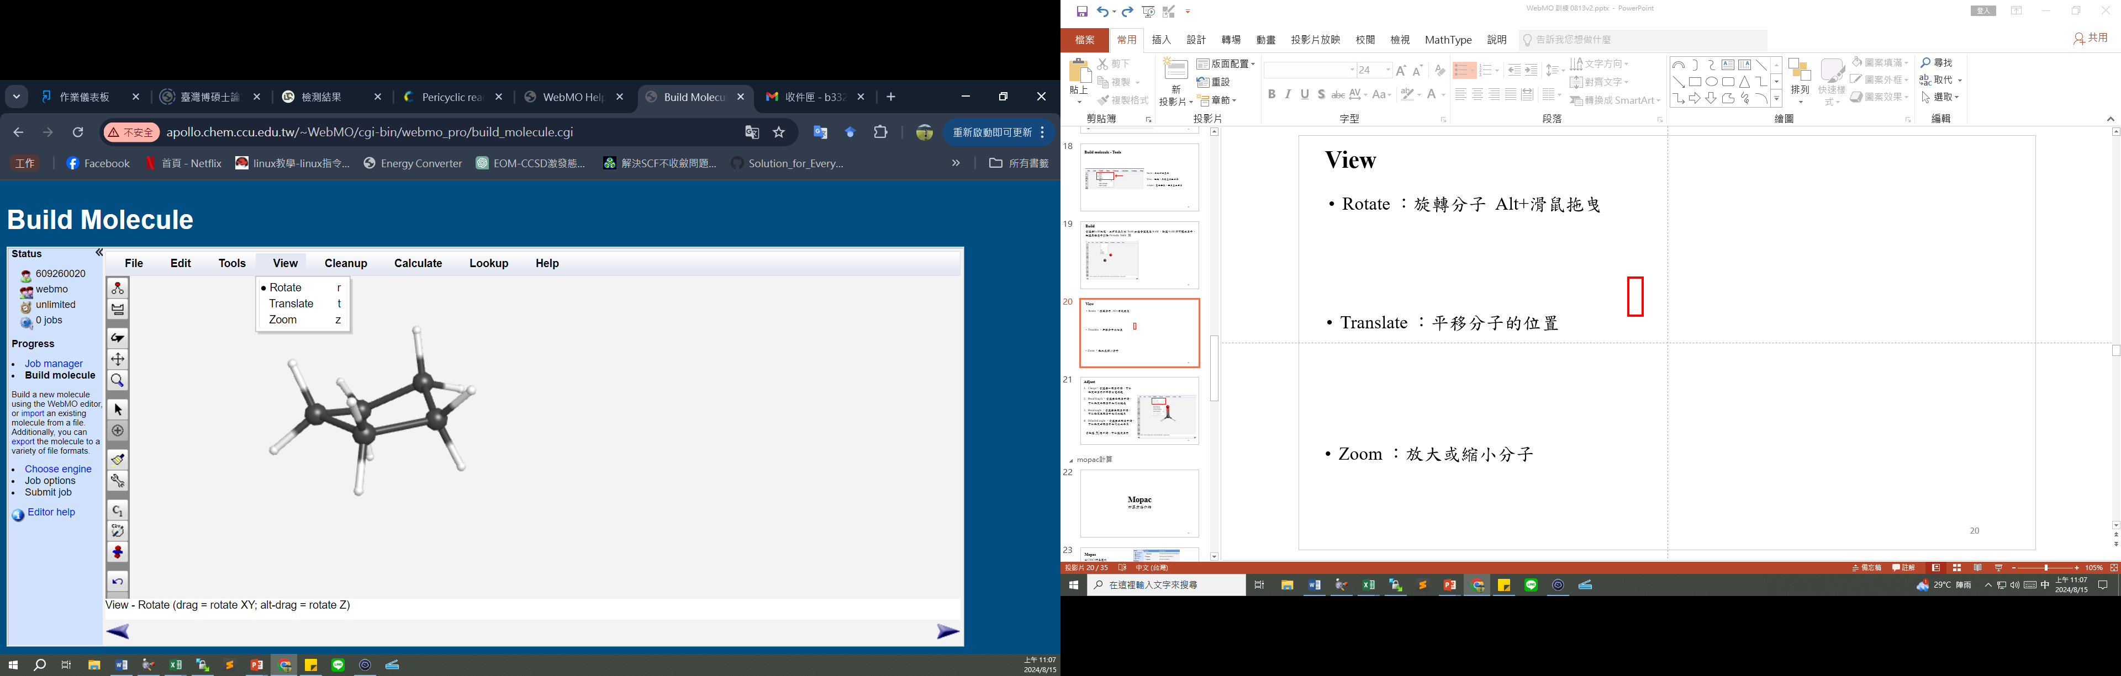
View
Rotate
X、Y axis : Mouse dragging
Z axis : Alt+Mouse dragging
Translate
Mouse dragging
Zoom
Mouse dragging

Slide 14
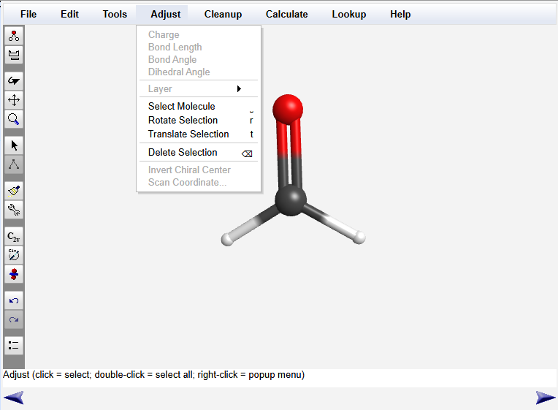
Adjust
Bond length ：Set the bond length of the two atoms
Bond angle ：Sets the bond angle between the three atoms
Dihedral angle ：Set the dihedral angle of the four atoms
When the icon is clicked, the atom can be selected

Slide 15
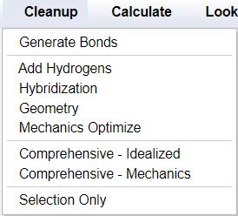
Cleanup
Add Hydrogen
Hybridization
Geometry
The above steps need to be completed in order

Slide 16
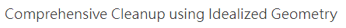
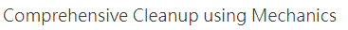
Cleanup
Comprehensive − Idealized
Conform to VSEPR
Comprehensive − Mechanics
Use Molecular Mechanics Force Fields (MMFF)
Do not consider the effect of e- commerce

Slide 17
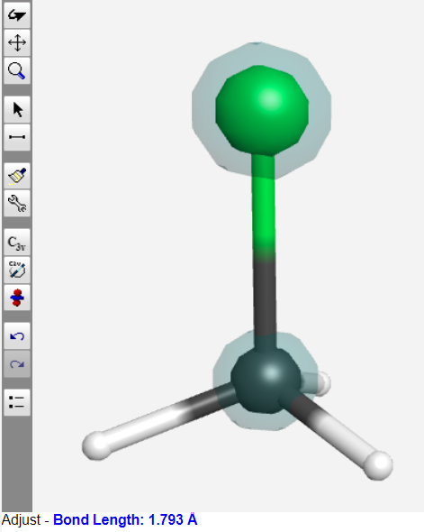
Measure Bond Length
Click on the two atoms you want to measure the length of the bond

Slide 18
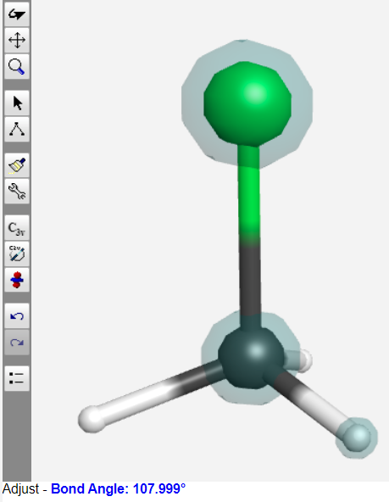
Measure Bond Angle
Click on the three atoms you want to measure the bond angle

Slide 19
Compare with Experimental Structure
CH₃Cl experimental value：
Optimized structure by MMFF：
1.767 Å
1.793 Å
109.1∘
108.0∘
1.092 Å
1.113 Å
109.9∘
110.9∘

Slide 20
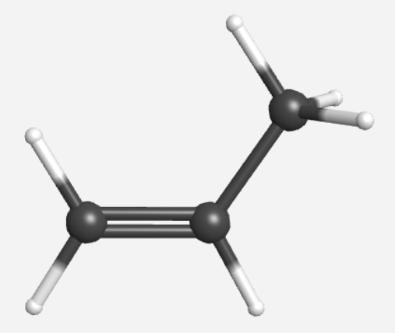
Build Molecule
Propylene(C₃H₆)：
Click in the window to insert a C atom, pull outward along C twice to create C=C, and pull the other way form a new C-C
Choosing Cleanup allows for initial structural optimization

Slide 21
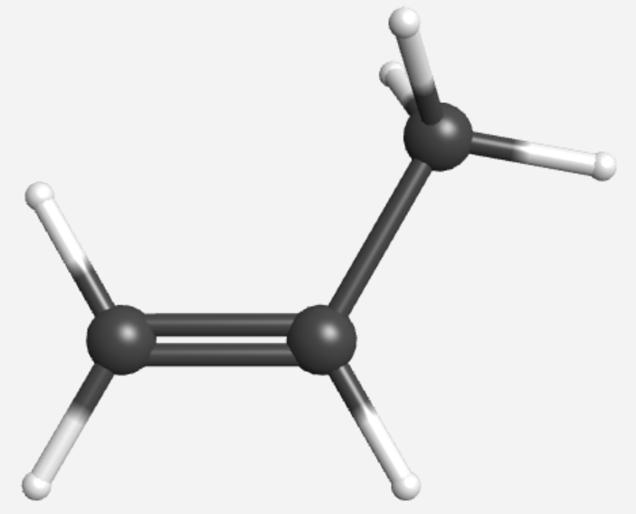
Compare with Experimental Structure
C₃H₆ experimental value ：
MMFF Optimized structure ：
108.2∘
107.9∘
1.095 Å
1.114 Å
1.085 Å
124.0∘
1.492 Å
1.102 Å
123.9∘
1.340 Å
1.505 Å
1.337 Å
118.0∘
117.2∘
117.6∘
117.0∘
1.086 Å
1.104 Å

Slide 22
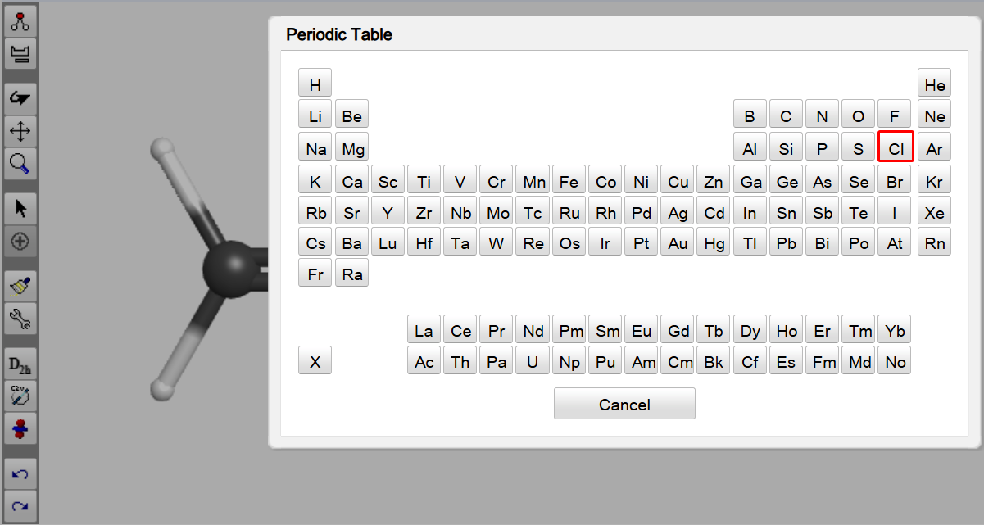
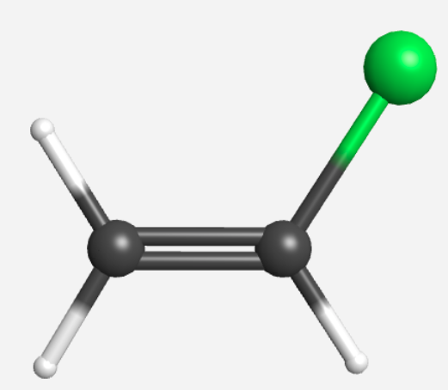

Build Molecule-Replace Atom
Vinyl chloride (C₂H₃Cl)：
Click in the window to insert the C atom, and pull it out along C to produce C-C. Pull it again to form a double bond.
Choose Cleanup
Replace one of the hydrogen atoms with chlorine. Click the button,
select chlorine, then click on the hydrogen atom you want to replace.
4. Cleanup again

Slide 23
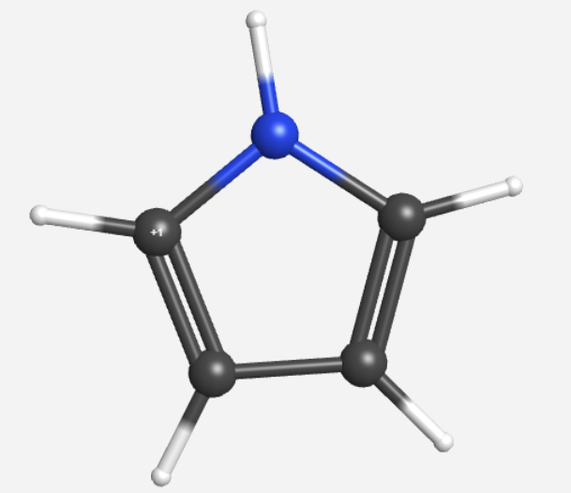
Build Molecule
Pyrrole：
Press once in the window to insert the C atom, and C pulls outward to produce C-C, forming a five-member ring. When the double bond is pulled, replace the middle C by N
Choosing Cleanup

Slide 24
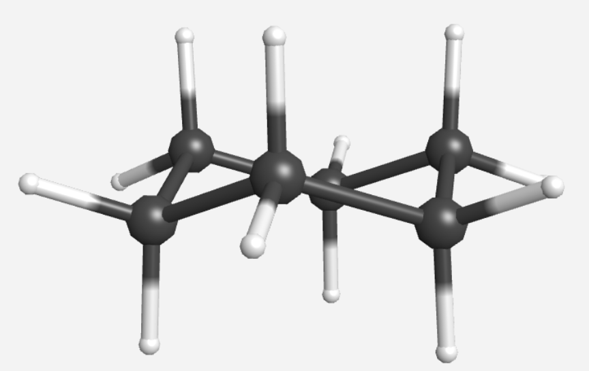
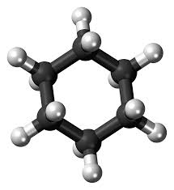
Build Molecule
Cyclohexane (C₆H₁₂)：
Click in the window to insert the C atom. Pull from C to form new C-C bonds, repeat and close the ring to form cyclohexane.
Choose Cleanup to optimize the molecule with MMFF.

Slide 25
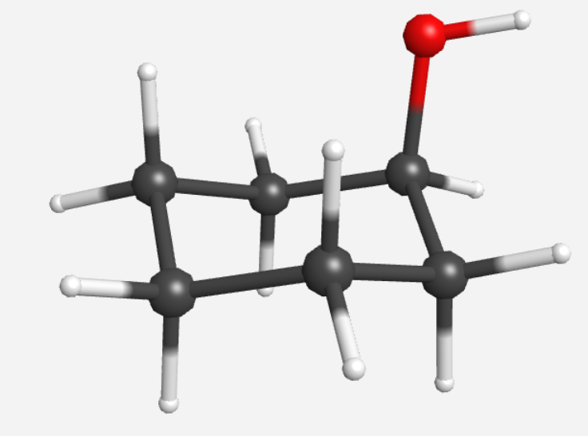
Build Molecule
Cyclohexanol ：
Press once in the window to insert the C atom, and drag the C atom in the C atom to insert the C atom to form a six-membered ring
Choosing Cleanup
Swap one H for O
Choose Cleanup

Slide 26
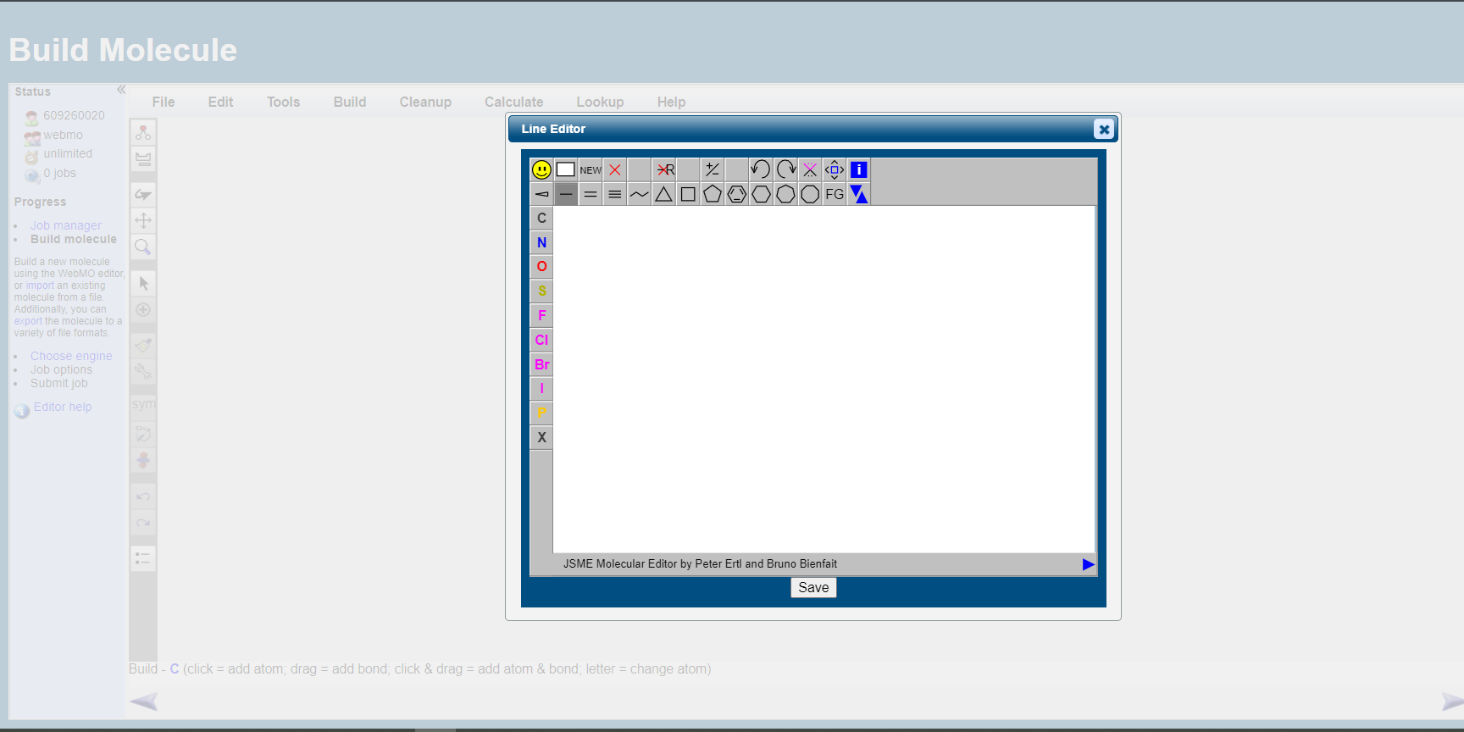
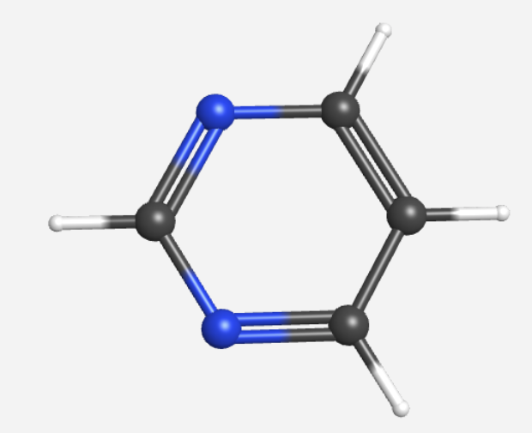
Build Molecule-Line Editor
Create Pyrimidine using 2D Line Editor

Slide 27
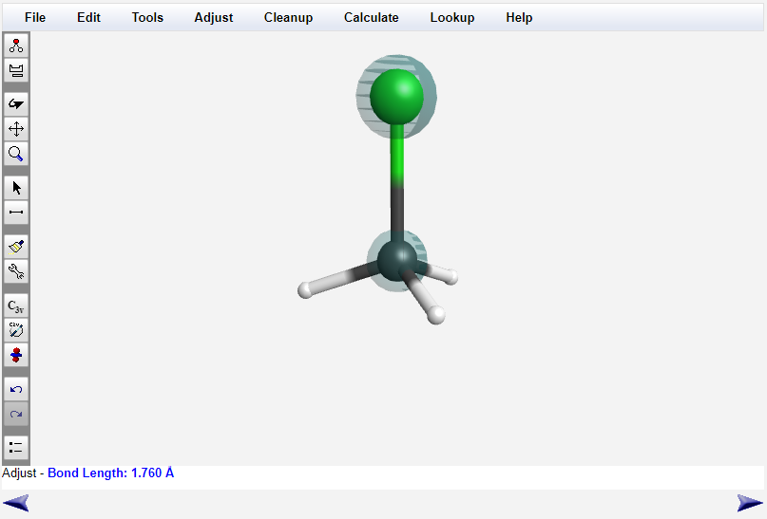

Edit Bond Length
2
1
3
4

Slide 28
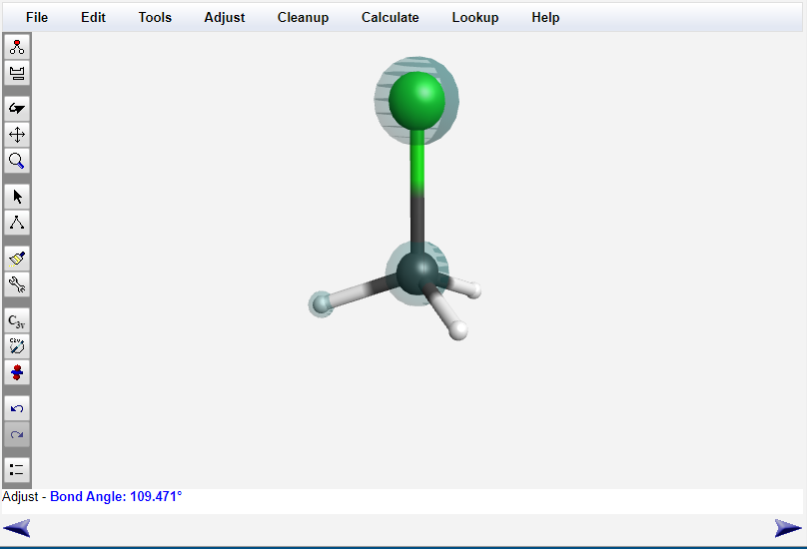

Edit Bond Angle
2
1
3
4

Slide 29
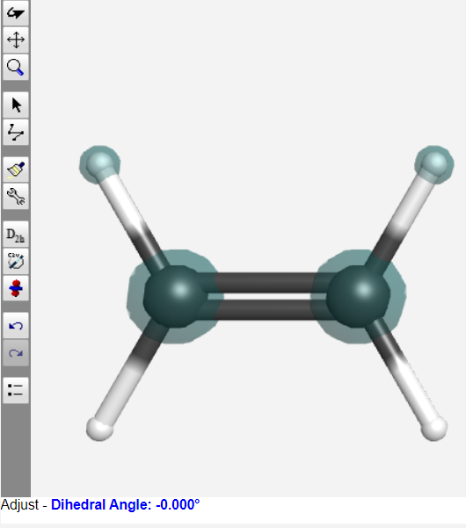
Measure Dihedral Angle
Click on the four atoms you want to measure the dihedral angle

Slide 30
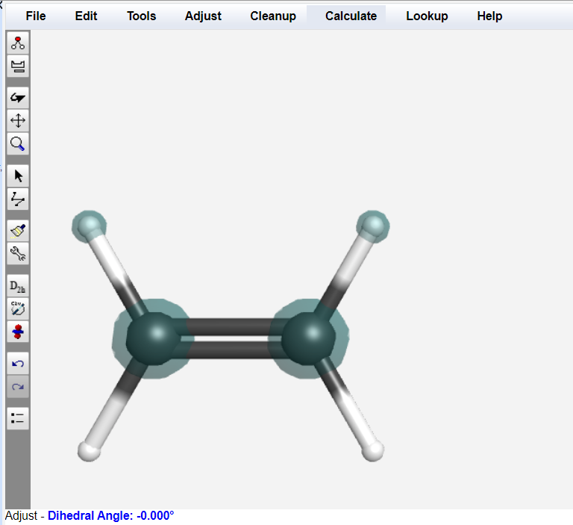
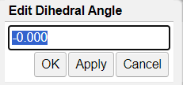
Edit Dihedral Angle
1
3
2
4

Slide 31
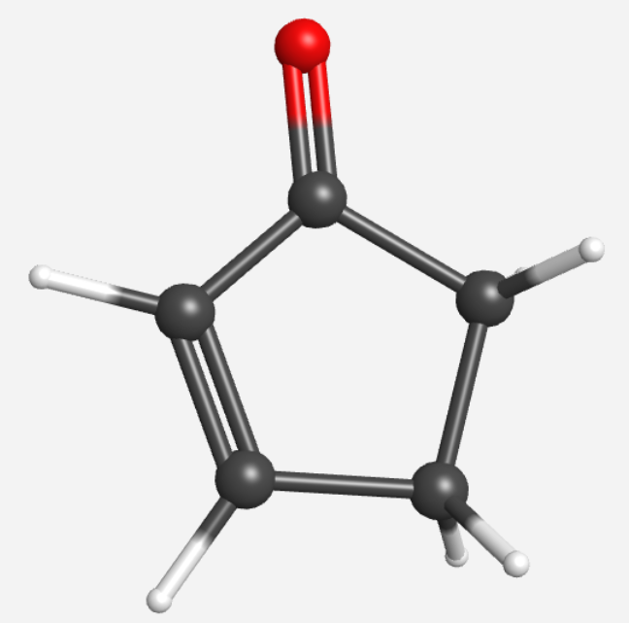
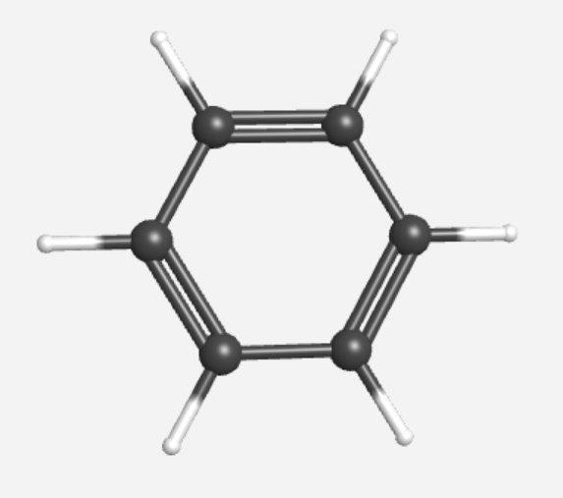
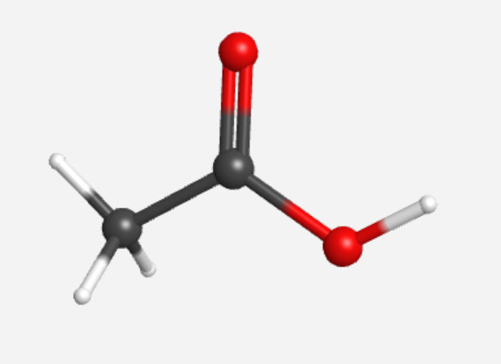
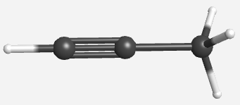
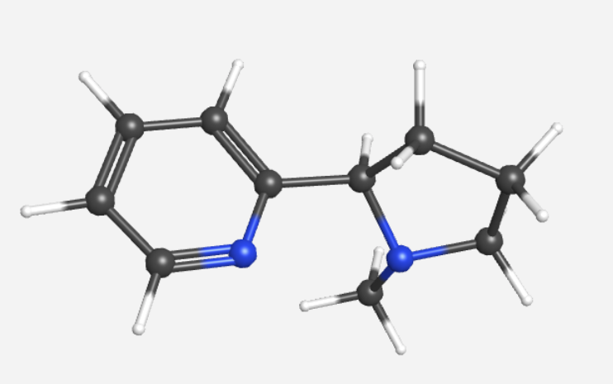
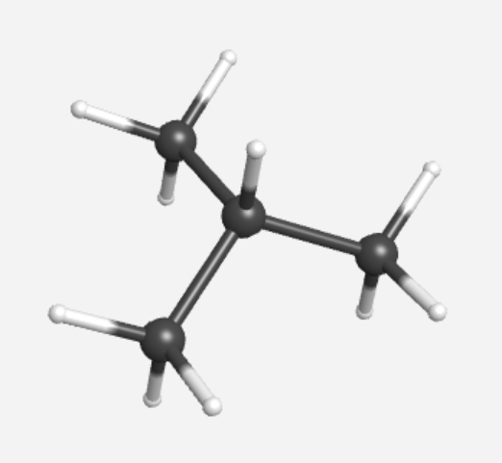
Exercise
Propyne
Cyclopentenone
Acetic acid
iso-butane
Nicotine

Slide 32
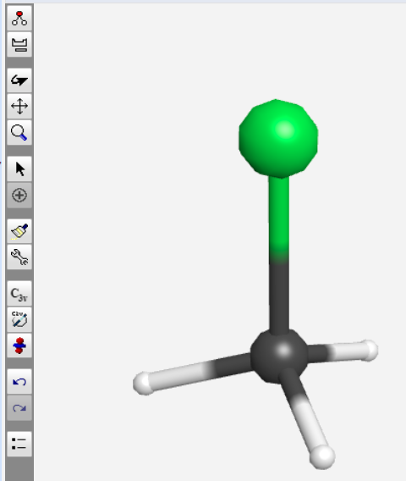
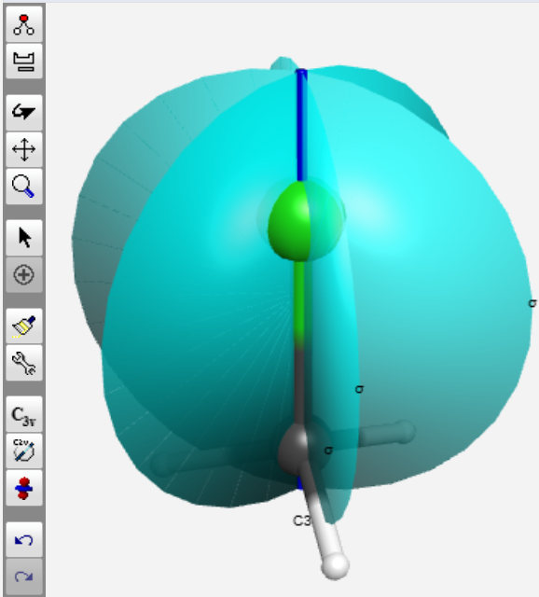

Point Group and Symmetry Elements
Molecular symmetry can be obtained on the side
Symmetry elements can be show by click the button

Slide 33
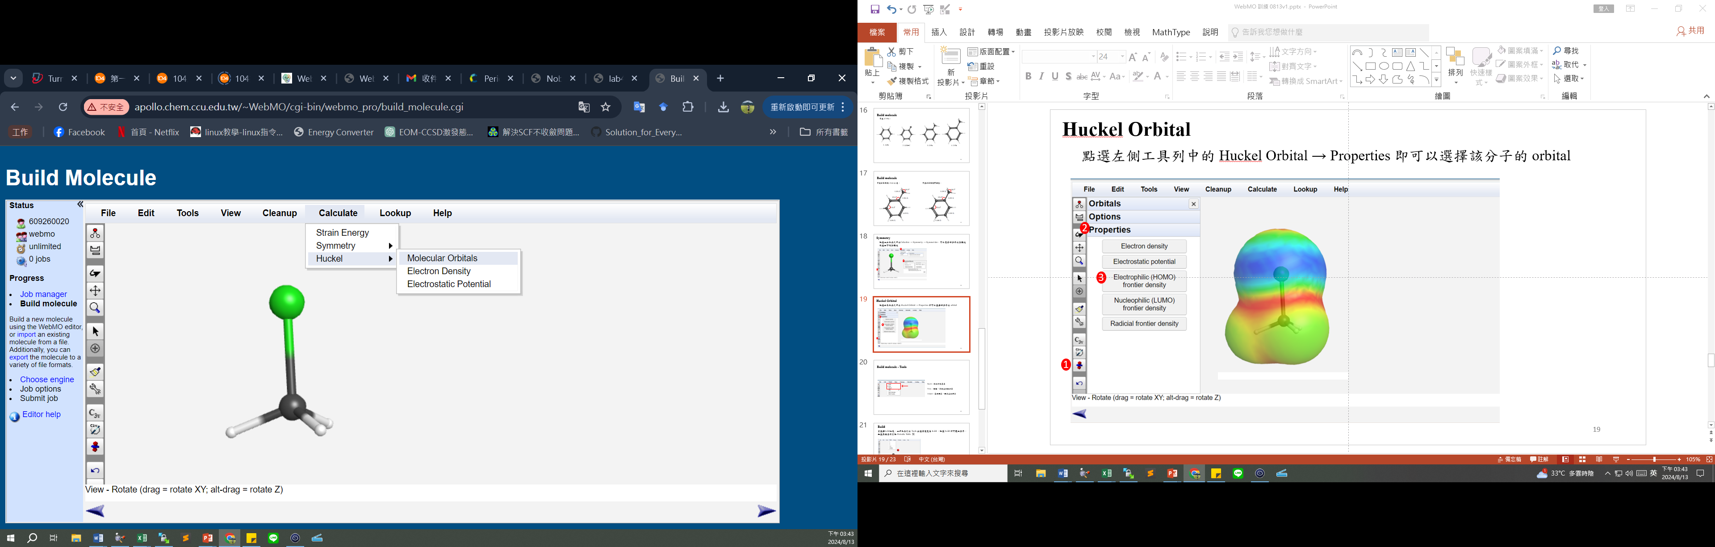
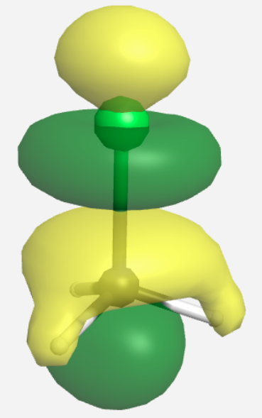
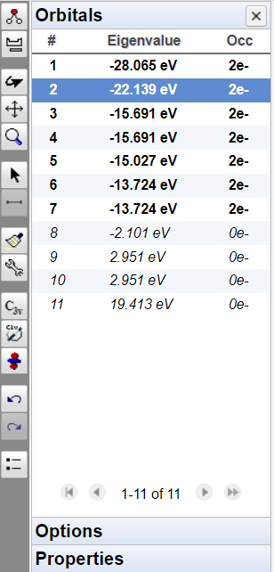
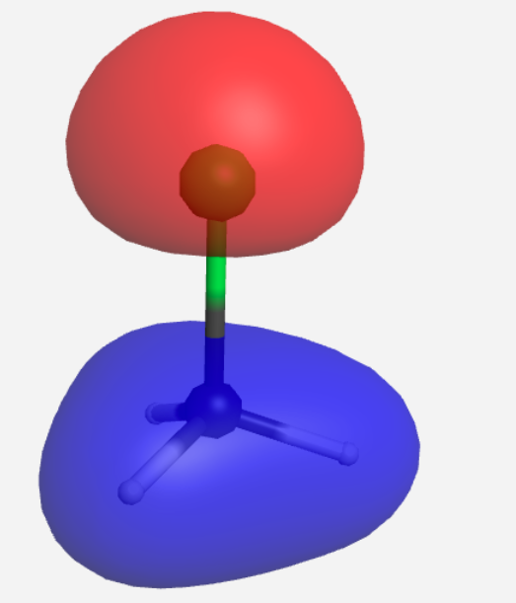
Hückel Orbital
Select Calculate → Hückel → Molecular Orbitals in the left toolbar.
You can select the orbital of the molecule, which is Frontier Molecular Orbital
1
Occupied orbitals
Unoccupied orbitals
3
4
2

Slide 34
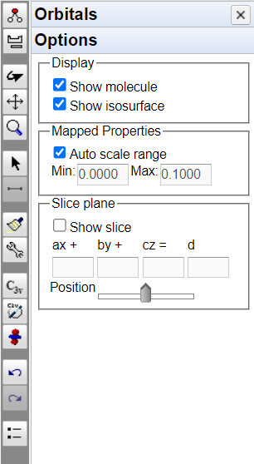
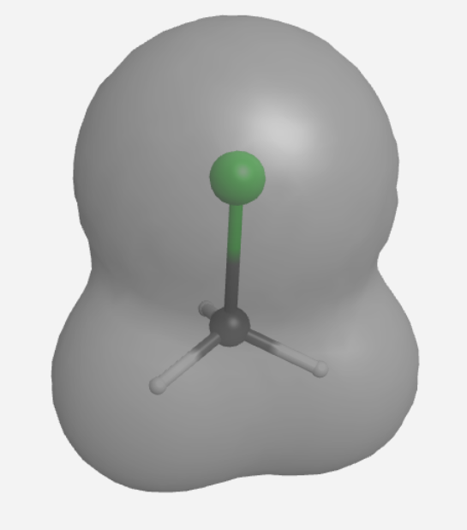
Hückel Calculation
Select Calculate → Hückel → Molecular Orbitals in the left toolbar.
1
2
3
4
Electron density

Slide 35


Hückel Calculation
Select Calculate → Hückel → Electrostatic Potential
1
2
Electrostatic potential
3
4

Slide 36
Quantum chemical calculations
Advanced - Introduction to Computational Methods in Quantum Chemistry

Slide 37

Molecular Orbital PACkage (MOPAC)
MOPAC is a free software with a semi-empirical approach, which can be used directly in WebMO. Commonly used theoretical methods include: AM1, PM3, etc
The semi-empirical method, which is fast to calculate, can calculate structural optimization, vibration frequency analysis, and contains a wave function to generate atomic charge and electron density distributions. In order to obtain more accurate values than the experimental values, further quantum chemistry methods are needed in the textbooks of physical and chemical experiments.
It does not take into account electron-related effects, cannot change the substrate function and theoretical methods, and has low accuracy
References:https://en.wikipedia.org/wiki/MOPAC

Slide 38


Quantum chemical calculations
The MMFF method used above does not consider the effects of electrons, and the methods of quantum chemistry are used to account for electron-related effects.
Mopac Engine Theory : PM3

Slide 39
Single-point calculation of energy(SP)

Slide 40
Single-point calculation of energy (SP)
Use Mopac Engine
Theory : PM3
Calculate the electron affinity of fluorine atoms
F + e⁻ → F⁻ (expt: 78.4 kcal/mol)
Reaction N₂ + 3H₂ → 2NH₃ (expt: -22.1 kcal/mol)
Notes:
-1-0

Slide 41
Structural Optimization Calculations (OPT)

Slide 42




Structural Optimization Calculations (OPT)
Use Mopac Engine
Calculate the bond lengths (Theory : PM3)
CH₃Cl、C₆H₆ 、HCHO、CH₃COOH、CH₃ON
Notes:
1.786 1.764
1.078 1.094
108.4 109.9

Slide 43





振動頻率計算 (FREQ)
1
Find the calculated optimal structure and click on it
Clicking on the arrow in the bottom right corner will take you to the editing page again
2
3
4
Select Mopac for Engine and Vibrational Frequencies for Calculation

Slide 44
IR Spectrum Simulation

Slide 45

IR Spectrum Calculation
Confirmed as the lowest point of energy
The optimized structure may not be the lowest point of energy
Simulate or predict IR spectra
It can be compared with experimental spectra to confirm unknowns
Understand the atomic motion corresponding to the vibrational spectrum
Note:
The same method must be used for structural optimization
It is very time-consuming, and it is better to use a theory that has an analytical quadratic differentiation

Slide 46


Calculated Quantities
After the calculation is completed, a new output file will be generated on the main page, at this time, you can click to find Vibrational Modes, and click on the right to be the vibrational mode at that frequency.
You can view the IR spectrum

Slide 47


Exercise
The IR spectra of CH3Cl were simulated and compared with experiments
Theory:PM3
There are 3*5 – 6= 9 vibration frequencies,
They are:676, 1007, 1007, 1345, 1384,
1384, 3123, 3123, 3194 cm⁻¹

Slide 48


Molecular Orbital
Select the structure to be calculated → Molecular Orbitals using PM3

Slide 49

Molecular Orbital
Once the calculation is complete, a new output file will be generated, at which point you can click to find Molecular Orbital
Electron density

Slide 50

Molecular Orbital
Once the calculation is complete, a new output file will be generated, at which point you can click to find Molecular Orbital
Electrostatic potential
Auto scale range. Don't choose the color is only available after adjusting the range

Slide 51


View the Symmetry Elements

Slide 52


Calculated Quantities
Scroll down to find it
Overview
Partial Charges
Bond Order

Slide 53

Overview
Describe the parameters of the calculation input, including the method used, the number of charges, the multiple states, as well as the symmetry of the molecule, the heat of generation, and the dipole moment

Slide 54

Partial Charges
It can know the charge of each atom in the molecule, and understand the ability of atoms in the molecule to pull electrons or donate electrons

Slide 55

Bond Order
The bonding of the individual atoms

Slide 56


Raw output
If you want to know more about the molecular structure, you can click on Raw output on the left to view the full output file

Slide 57
Thank You for Your Participation
Department of Chemistry and Biochemistry
National Chung Cheng University

